Slide 1
Seminar On FILE-SYSTEM FORMATTING
Mr . Mayur Patil Seminar Guide
-By
Chetan Pawar(TE-A-59) Nishant Kumar(TE-A-41)

Slide 2
Problem statement
Design and implement file system format program which will copy host OS file system and formats secondary storage such as Flash drives, USB drives with same file system.

Slide 3
OBJECTIVE
Format the secondary storage devices such as Flash drives, USB drives with file system such as-
1)ext4
2)NTFS
3)Fat32
4)Btrfs
5)Reiserfs

Slide 4
abstract
In computing, a file system or file system is used to control how data is stored and retrieved.
File systems can be used on numerous different types of storage devices that use different kinds of media. The most common storage device in use today is a hard disk drive.
Other kinds of media that are used include flash memory, magnetic tapes, and optical discs. In some cases, such as with tmpfs, the computer's main memory (random-access memory, RAM) is used to create a temporary file system for short-term use

Slide 5
introduction
In computing, a file system is used to control how data is stored and retrieved.
Without a file system, information placed in a storage medium would be one large body of data with no way to tell where one piece of information stops and the next begins. By separating the data into pieces and giving each piece a name, the information is easily isolated and identified.
Taking its name from the way paper-based information systems are named, each group of data is called a "file". The structure and logic rules used to manage the groups of information and their names is called a "file system".

Slide 6
File-system
There are many different kinds of file systems. Each one has different structure and logic, properties of speed, flexibility, security, size and more. Some file systems have been designed to be used for specific applications. For example, the ISO 9660 file system is designed specifically for optical discs.
The file system provides the mechanism for online storage and access to file contents, including data and programs

Slide 7
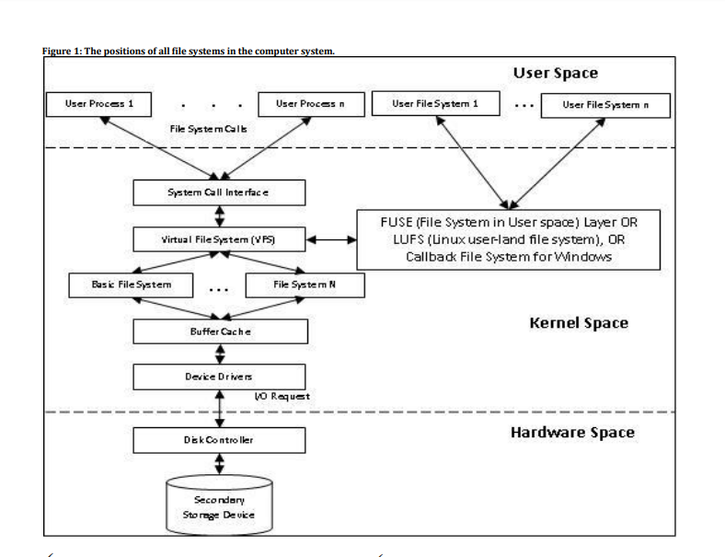
File-system(uml-diagram)

Slide 8
FILE-SYSTEMS USED
Ext4:
Maximum file size : 16 TiB
Maximum volume size : 1 EiB
Maximum number of files : 4 billion
Maximum file name length : 255 characters
Uses a journal
Command: mkfs.ext4 <path>

Slide 9
FILE-SYSTEMS USED
2. FAT32:
Maximum file size : 4 GiB
Maximum volume size : 16TiB
Maximum number of files : 4 billion
Maximum file name length : 255 characters
Uses a journal
Developed by Microsoft(1996)
Command: mkfs.vfat <path>

Slide 10
FILE-SYSTEMS USED
3. NTFS:
Maximum file size : 16 TiB
Maximum volume size : 16 EiB
Maximum file name length : 255 characters
Developed By Microsoft(1993)
Command: mkfs.ntfs <path>

Slide 11
FILE-SYSTEMS USED
4. BtrFs:
Maximum file size : 16 EiB
Maximum volume size : 16 EiB
Maximum number of files : 1e+19
Maximum file name length : 255 characters
Developed by Oracle(2007)
Command: mkfs.btrfs <path>

Slide 12
FILE-SYSTEMS USED
5. ReiserFs:
Maximum file size : 8 TiB
Maximum volume size : 16 TiB
Maximum number of files : 4 billion
Maximum file name length : 255 characters
Developed by Namesys(2001)
Command: mkfs.reiserfs <path>

Slide 13
ALGORITHM
1. Find the current file system of the device.
Command : df –Th
Example:
data=os.popen('df -Th').read()

Slide 14
ALGORITHM
2. Unmount the device.
Command : umount “<path>”
Example:
unmount_cmd = 'umount '+loc os.system('gksudo '+unmount_cmd)

Slide 15
ALGORITHM
3. Write the new file system you want to write.
Command: mkfs . ”<filesystem type>” “<path>”
Example:
fat32_format_cmd = 'mkfs.vfat '+loc
os.system('gksudo '+fat32_format_cmd)

Slide 16
technologies used
1. Python3 :
Python is an interpreted high-level programming language for general-purpose programming.
2. Django Framework:
Django is a free and open-source web framework, written in Python, which follows the model-view-template (MVT) architectural pattern.
3. HTML:
Hypertext Markup Language (HTML) is the standard markup language for creating web pages and web applications.
4. CSS:
Cascading Style Sheets (CSS) is a style sheet language used for describing the presentation of a document written in a markup language.
5. gksudo:
GKsudo prompting for root access, to open the Synaptic Package Manager.

Slide 17
conclusion
This seminar tells about the various file systems that may be the user file systems which has the interface kernel.
Different File systems has different uses in
Various aspects in file name and file storage.

Slide 18
THANK You!

